Slide 1


Information Technology Course
Module Software Engineering
Implement
the Spatial Pooler
SDR Reconstruction
Musab Chishti
Nithin Benny
Abdul Rehman
Adeleh Behboodi
1

Slide 2
OBJECTIVE
The aim of this project is to explores the application of the Neocortex API for processing both scalar data and images. Our approach involves utilizing a scalar encoder for numerical inputs and an image binarizer for image inputs. The outputs from these encoders are used to generate bitmaps, representing encoded representations of the input data.
2

Slide 3
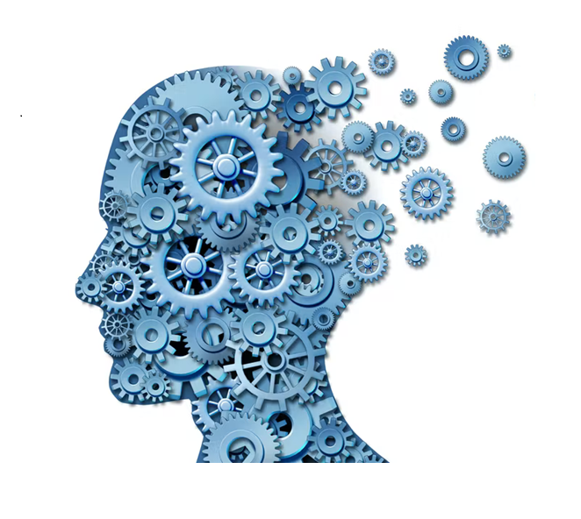
AGENDA
Introduction
Implementation of Reconstruct Method for Integer and Image
Exploring the Permanence value
Challenges in Reconstructing Input Values and Images
Conclusion

Slide 4
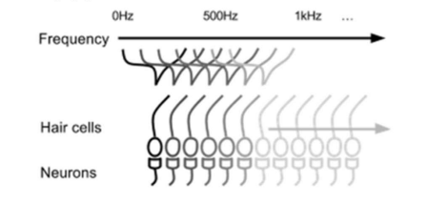
INTRODUCTION
The Neocortex API emerges as a powerful tool, offering a flexible framework for data processing tasks inspired by the biological principles of the neocortex. At the core of the Neocortex API lies the concept of Hierarchical Temporal Memory (HTM), a computational framework that mimics the structure and functionality of the neocortex—the region of the brain responsible for higher-level cognitive functions. HTM models consist of interconnected units called neurons, which communicate through synapses, mimicking the biological counterparts of dendrites and axons.
Dendrites, the receiving branches of neurons, play a crucial role in aggregating input signals from other neurons. Through a process known as spatial pooling, HTM models simulate the activation of dendritic segments based on the input data, resulting in Sparse Distributed Representations (SDRs) that capture the underlying patterns within the data.
Cochlear hair cells excite a group of neurons based on the frequency of the sound.
4

Slide 5
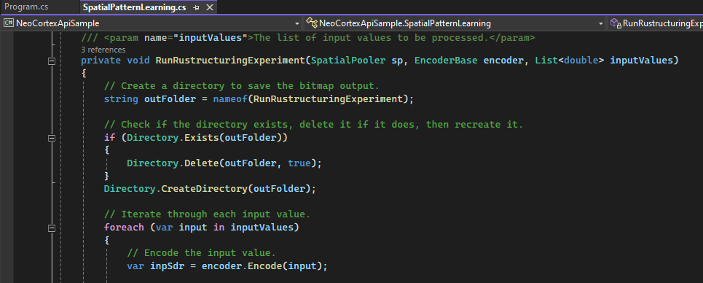
Implementation of Reconstruct Method for Integers and Images
The method for Integer is designed to conduct an experiment that involves encoding input values using a specified encoder, performing spatial pooling using a spatial pooler, reconstructing probabilities from active columns, applying thresholding, and analyzing the similarity between the original encoded input and the thresholded values.

Slide 6
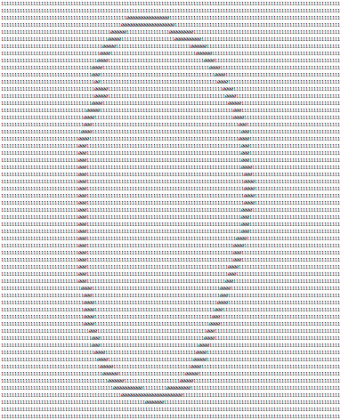
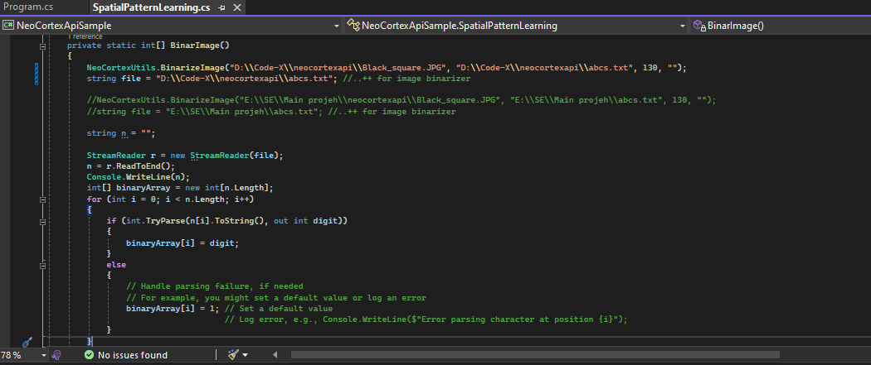
The method for Image is designed to conduct an experiment that involves encoding image using a image binarizer, performing spatial pooling using a spatial pooler, reconstructing probabilities from active columns, applying thresholding, and analyzing the similarity between the original encoded input and the thresholded values.

Slide 7
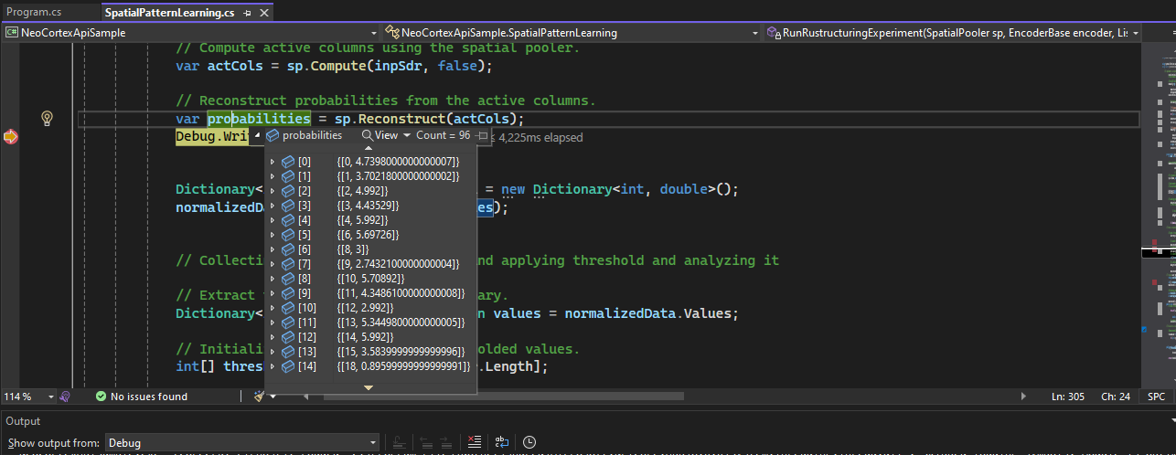
Exploring the Permanence value
The method collects permanence values from the reconstructed probabilities, applies a threshold to segregate values between 0 and 1, and analyzes the similarity between the original and thresholded arrays. The similarity is calculated as the percentage of matching elements.

Slide 8
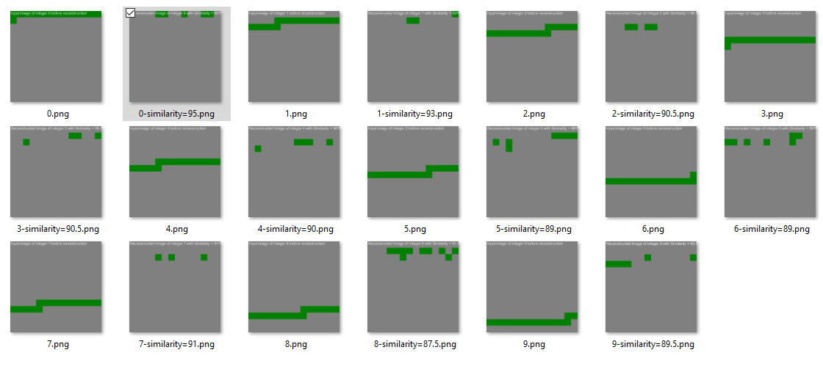
Challenges in Reconstructing Input Values and Images
The process of reconstructing input values from SDRs can be computationally expensive and time-consuming, particularly when dealing with large-scale datasets or real-time data streams.
One of the main difficulties in reconstructing input values is the loss of information during the encoding process. HTM systems encode input data into sparse distributed representations, which may not capture all the details and nuances of the original data.
8

Slide 9
CONCLUSION
Upon execution of the integers, we observed that we are getting reconstructed images with similarities ranging from 70% to 95%. We also notice some noises even after normalising the permanence values. In order to reduce the noise, we increased the threshold, but it impacts our reconstructed image. It can be noticed that some parts of the reconstructed images are impacted. We can improve the similarity by varying the threshold value but there will be additional noises.
While working with images, we observed that we are getting reconstructed images with similarities ranging from 40% to 50%. We also notice that there are more noises as compared to integer input even after normalizing the permanence values. In order to reduce the noises, we increased the threshold, but it impacts our reconstructed image. It can be noticed that a large part of the reconstructed image is impacted.

Slide 10
SOURCES CITED
S. P. S. Ahmad, "arxiv.org," [Online]. Available: https://arxiv.org/abs/1705.05363.
S. A. J. Hawkins, "www.frontiersin.org," [Online]. Available: https://www.frontiersin.org/articles/10.3389/fncir.2016.00023/full.
S. &. H. .. Ahmad, "Properties of sparse distributed representations their application to hierarchical temporal memory," doi: 10.1371/journal.pone.0022149, no. 1, 2011.
10

